Slide 1
软件项目管理 主讲：赵梦辰

Slide 2
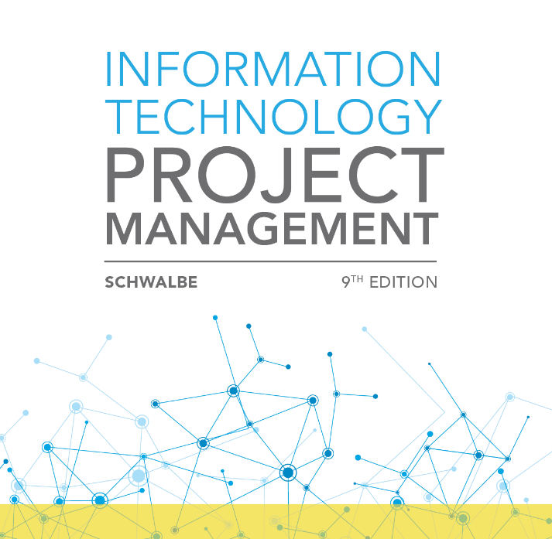
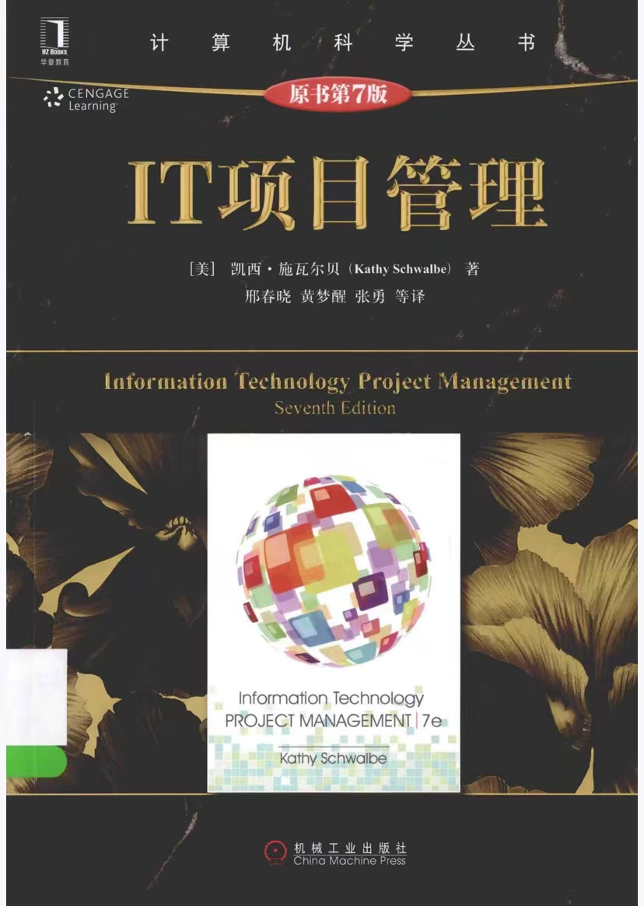
课程简介
软工专业核心必修课
课时：理论课 48课时
教材：Information Technology Project Management
（第9版或第7版）

Slide 3
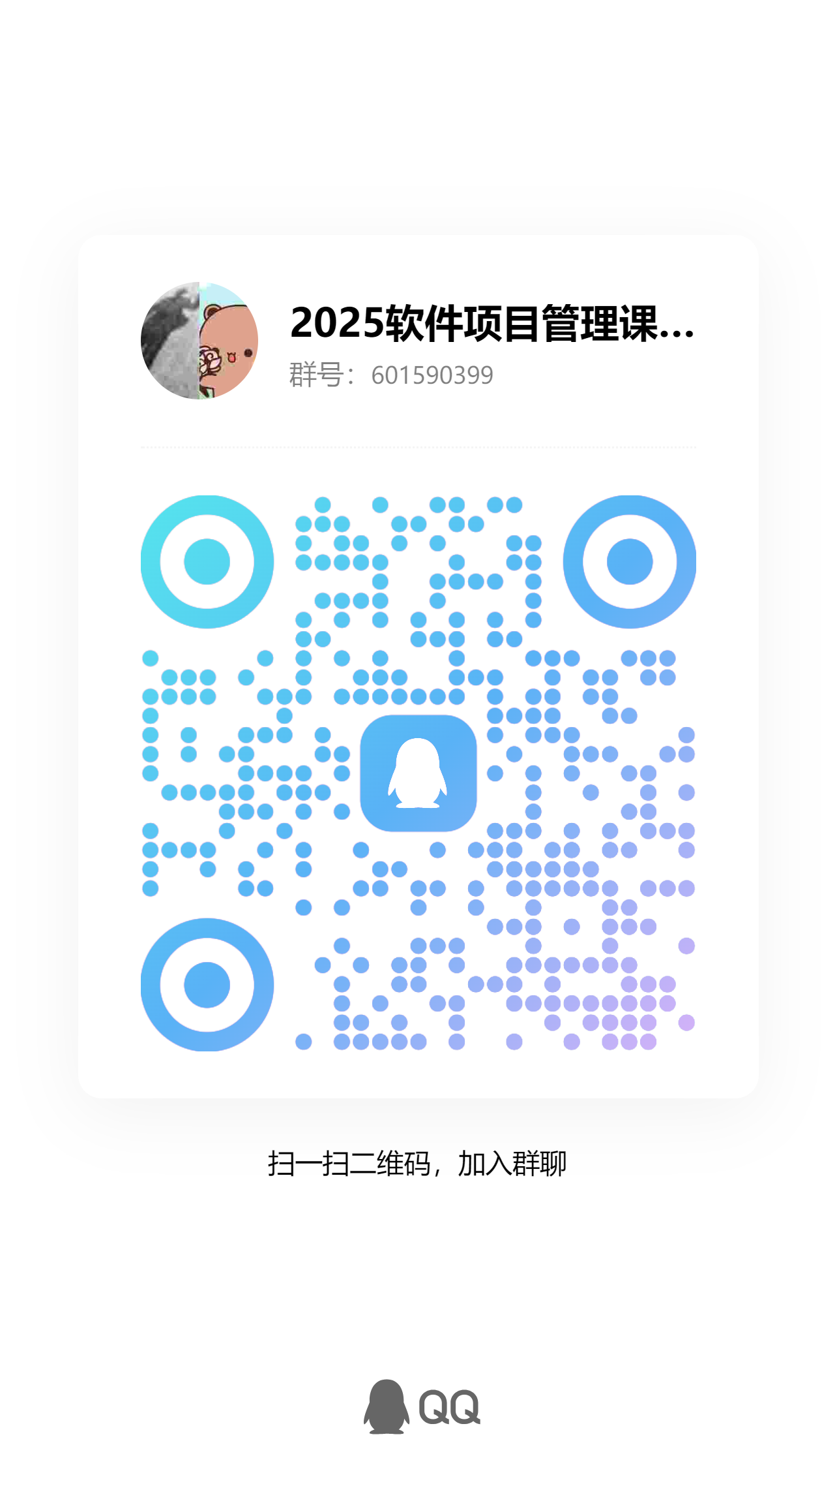
课程简介
课程QQ群：见右侧二维码
助教：刘志杰 1050638502@qq.com
成绩：期末考试50%，大作业（可能+期中考）40%，平时成绩10%
期末考试：英文试卷。选择/名词解释（25-30分）；简答题（25分）；计算题（30分）； 分析题（15-20分）
大作业：具体要求待定，每组不超过4人，需做口头报告
平时成绩：初始分5分，缺勤扣5分，回答问题加2分

Slide 4
Introduction to Project Management
2

Slide 5





Introduction (1 of 3)
n Many people and organizations today have a new or renewed interest in project management
n Statistics show the significance of project management today, especially for the IT projects
Worldwide IT spending was $3.5 trillion in 2017, a 2.4% increase from 2016 spending. Communications services accounted for 40% of the spending.
PMI’s 2021 Talent Gap report states that “The global economy needs 25 million new project professionals by 2030.”
LinkedIn lists “project manager” as #3 in the top 10 jobs identified as having the greatest number of openings, steady growth, and a livable wage.
The top skills employers look for in new college graduates are all related to PM: team-work, problem-solving, and verbal communications.
Organizations waste an average of $97 million per $1 billion spent on projects, due to poor project performance (PMI’s Pulse of the Profession® , 2017).
3

Slide 6



Introduction (2 of 3)
n IT Projects have a terrible track record
n A 1995 Standish Group study “The CHAOS Report”
the overall success rate of IT projects was only 16.2%, in terms of meeting project time and budget goals
more than 31% of IT projects were canceled before completion, costing U.S. companies and government agencies more than $81 billion
n PricewaterhouseCoopers surveyed 200 companies from 30 countries
about their PM maturity and found that over 50% projects fail, and only
2.5% of corporations consistently meet their targets for scope, time, and cost goals for all types of projects.
Good project management is crucial to the success of projects
in the (IT) industries!
4

Slide 7
Introduction (3 of 3)
n Many organizations assert that using project management techniques provides advantages such as
1. Better control of financial, physical, and human resources
2. Improved customer relations
3. Shorter development times
4. Lower costs and improved productivity
5. Higher quality and increased reliability
6. Higher profit margins
7. Better internal coordination
8. Positive impact on meeting strategic goals
9. Higher worker morale
5

Slide 8




What is a Project?
n A project is “a temporary endeavor undertaken to create a unique product, service, or result”
n Operations vs. Projects
Operations focuses on the ongoing production of goods and services
Projects end when their objectives have been reached or the project has been terminated
n Examples of IT projects
A team of students creates a smartphone application and sells it online
A company develops a driverless car
A government group develops an IT system to track child immunizations
A global bank acquires other financial institutions and needs to consolidate systems and procedures
A large network of healthcare providers updates its information systems and procedures to reduce hospital acquired diseases
6

Slide 9
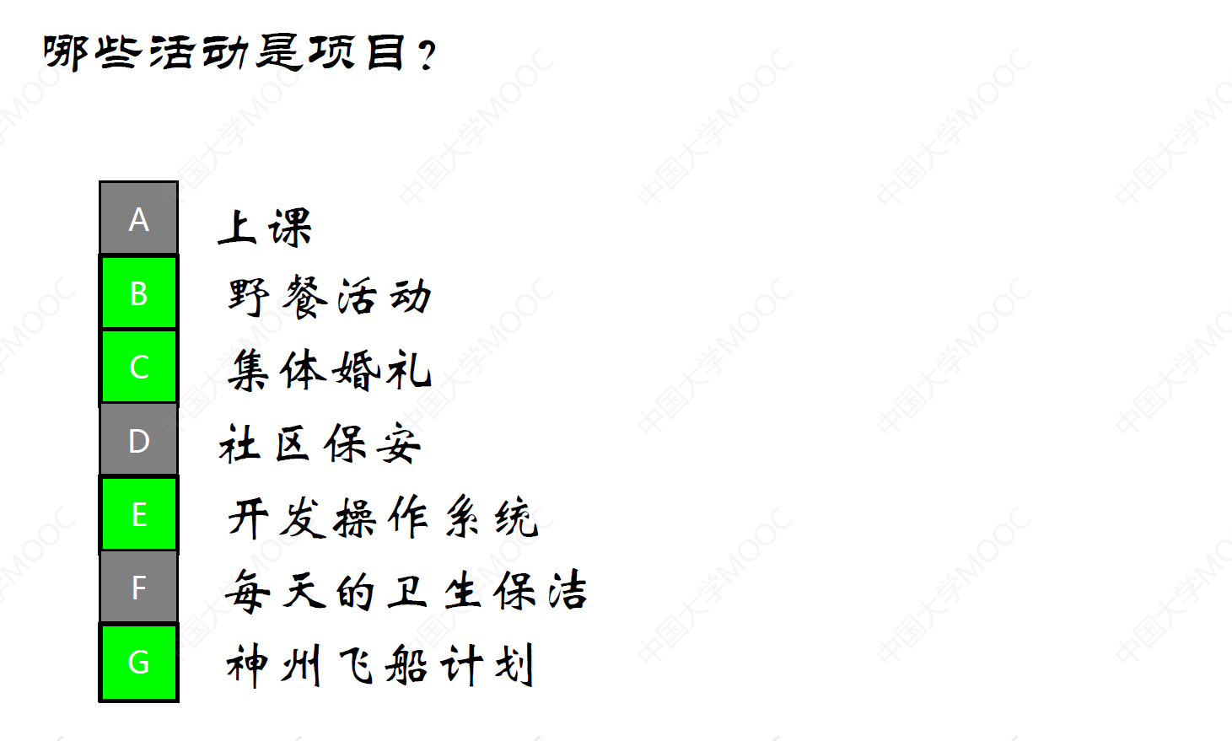

Slide 11


Project Attributes
n Projects come in all shapes and sizes. The following attributes help define a project further:
A project has a unique purpose
A project is temporary
A project drives change and enables value creation
A project is developed using progressive elaboration
A project requires resources, often from various areas
A project should have a primary customer or sponsor
A project involves uncertainty and risk
n An effective project manager is crucial to a project’s success. Project managers work with project sponsors, team, and other people involved in a project to achieve project goals.
7

Slide 12
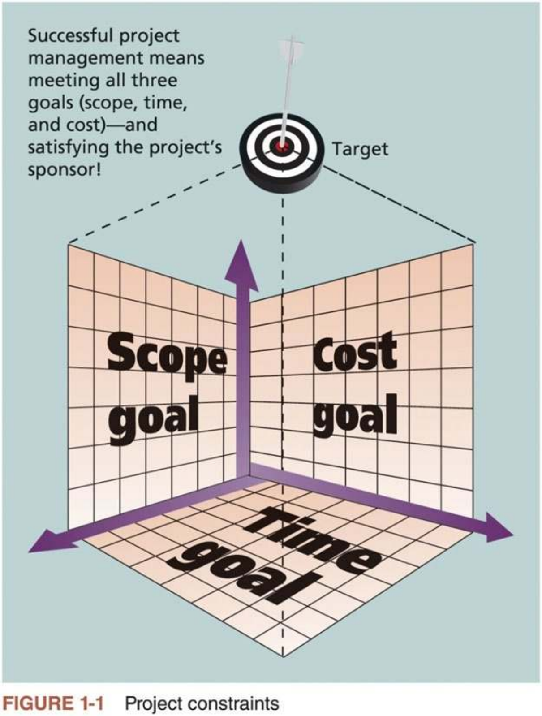


Project Constraints
n Every project is constrained in different ways, often by its scope, time, and cost goals, referred to as the triple constraint
Scope: What work will be done as part of
the project? What unique product, service, or
result does the customer or sponsor expect
from the project? How will the scope be
verified?
Time: How long should it take to complete
the project? What is the project’s schedule?
How will the team track actual schedule
performance? Who can approve changes to
the schedule?
Cost: What would it cost to complete the
project? What is the project’s budget? How
will the costs be tracked? Who can authorize
changes to the budget?
8

Slide 13

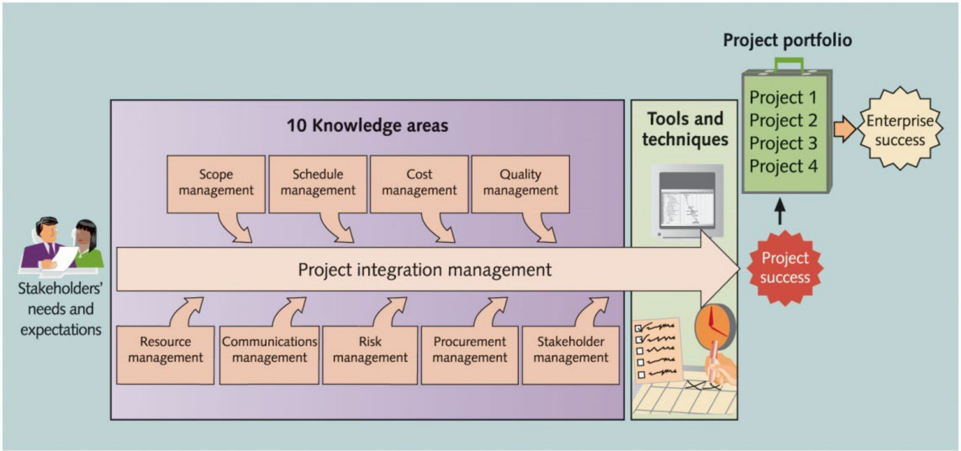
What is Project Management?
n Project management is “the application of knowledge, skills, tools, and techniques to project activities to meet project requirements”
Project managers strive to meet the triple constraints and facilitate the entire process to meet the needs and expectations of project stakeholders
9

Slide 14

Project Stakeholders
n Stakeholders are the people involved in or affected by project activities, such as project sponsor, project team, support staff, customers, users,
suppliers, and even opponents to the project
For example, what are the stakeholders in a construction project of building a new house?
n Projects have many different stakeholders, and they often have different interests and needs
Stakeholders’ needs and expectations are important at the beginning and throughout the life of the project
n Successful project managers develop good relationships with project stakeholders to understand and meet their needs and expectations
10

Slide 15
Project Management Knowledge Areas
n Knowledge areas describe the key competencies that project managers must develop. Figure 1-2 shows the following ten knowledge areas of project management:
1) Integration management (Lecture 2)
2) Scope management (Lecture 3)
3) Schedule management (Lecture 4)
4) Cost management (Lecture 5)
5) Quality management (Lecture 6)
6) Resource management (Lecture 7)
7) Communications management (Lecture 8)
8) Risk management (Lecture 9)
9) Procurement management (Lecture 10)
10) Stakeholder management (Lecture 11)
n Project managers must have knowledge and skills in all these areas
11

Slide 16



Project Management Tools and Techniques
n Project management tools and techniques assist project managers and their teams in various aspects of project management. For example,
Scope: project charter, scope statement, and WBS
Schedule: Gantt charts, network diagrams, critical path analysis, critical chain scheduling
Cost: cost estimates, earned value management (EVM)
n PMBOK® Guide (2017) lists project management tools and techniques based on their purpose:
Data gathering
Data analysis
Data representation
Decision making
Communication
Interpersonal and team skills
and several others
12

Slide 17

Project Success
n There are several ways to define project success:
The project met scope, time, and cost goals
The project satisfied the customer or sponsor
The results of the project met its main objective, such as making or saving a certain amount of money, providing a good return on investment, or simply making the sponsors happy
Factors of Success | Points
Executive sponsorship | 15
Emotional maturity | 15
User involvement | 15
Optimization | 15
Skilled resources | 10
Agile processes | 7
Modest execution | 6
Project management expertise | 5
Clear business objectives | 4
Table 1-2 What Helps Projects Succeed?
¹³

Slide 18


Program and Project Portfolio Management
n About one-quarter of the world’s GDP is spent on projects
n Two important concepts that help projects meet enterprise goals are the use of programs and project portfolio management
n A program is “a group of related projects managed in a coordinated
manner to obtain benefits and control not available from managing them individually”
Examples of common programs in the IT field include infrastructure, applications development, and user support
Program（美式） vs. Programme（英式）
n A program manager provides leadership and direction for the project managers heading the projects within the program
14

Slide 19
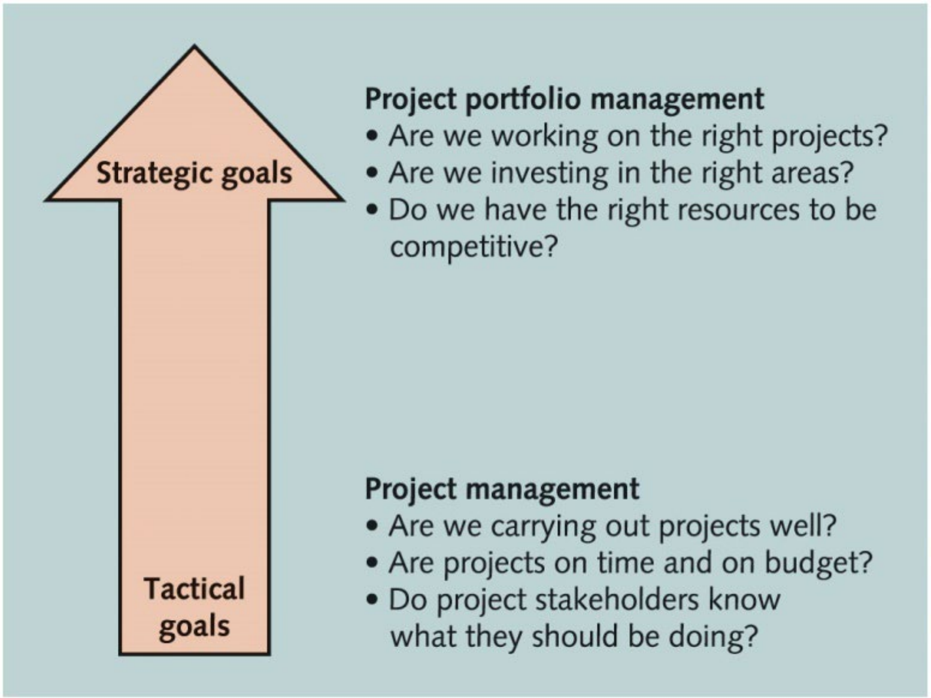
Project Portfolio Management
n As part of project portfolio management, organizations group and manage projects and programs as a portfolio of investments that contribute to the entire enterprise’s success
n Portfolio managers help their organizations make wise investment decisions by helping to select and analyze projects from a strategic perspective
战略
策略
15

Slide 20


Best Practice
n A best practice is “an optimal way recognized by industry to achieve a stated goal or objective”
Best practice secret: “Stretching to learn from the best of the best in any sector can make a big vision more likely to succeed.”
n Robert Butrick suggests that organizations need to follow some basic principles of project management such as
Make sure that your projects are driven by your strategy. Be able to
demonstrate how each project you undertake fits your business strategy, and screen out unwanted projects as soon as possible.
Engage your stakeholders. Ignoring stakeholders often leads to project failure. Be sure to engage stakeholders at all stages of a project and
encourage teamwork and commitment at all times.
16

Slide 21
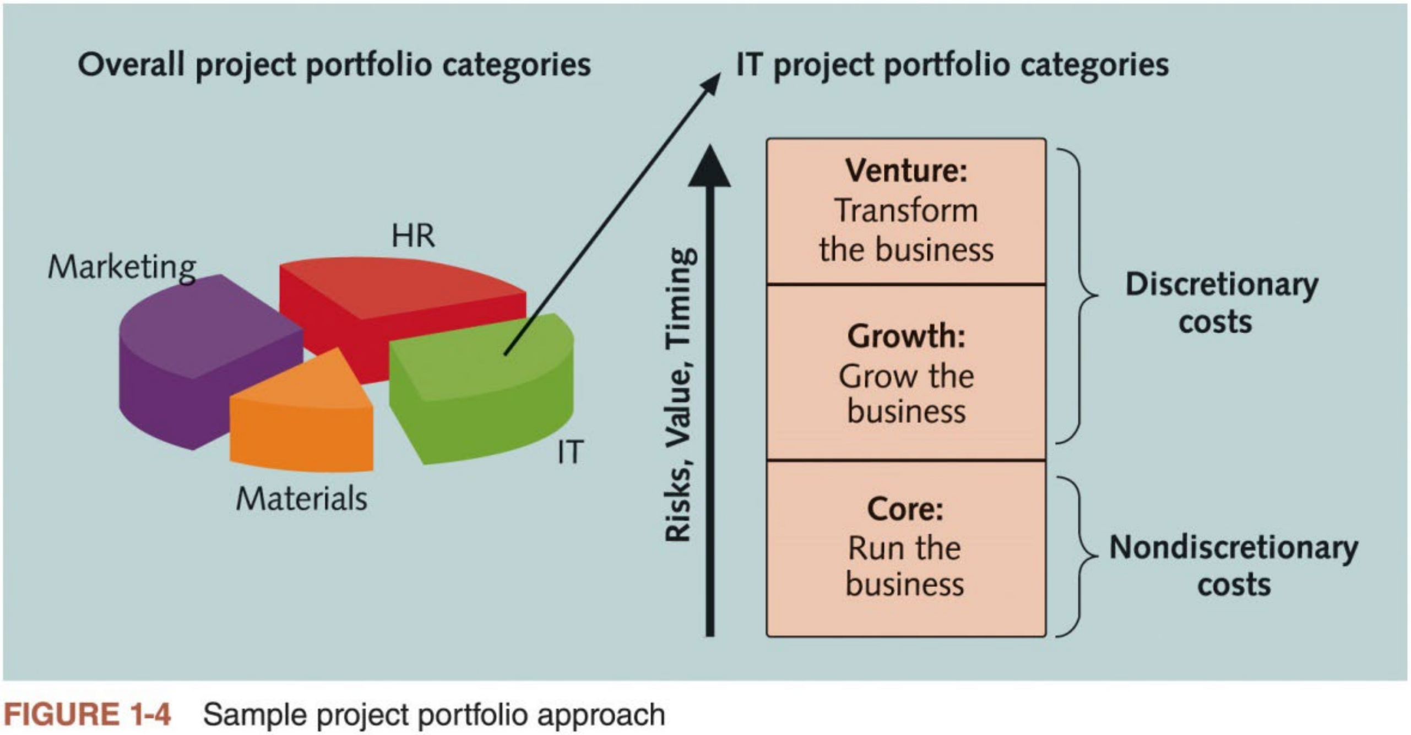
Organizational Project Management
n Organizational project management is a framework in which portfolio, program, and project management are integrated with organizational enablers in order to achieve strategic objectives
17

Slide 22

The Role of Project Manager
n Project managers must work closely with other stakeholders on a project, especially the sponsor and project team
More effective if they are familiar with the ten PM knowledge areas and the various tools and techniques related to project management
n Project manager job description
A project manager can have different job descriptions, which can vary tremendously by industry, organization, and project
However, most project managers perform similar tasks such as planning,
scheduling, coordinating, and working with people to achieve project goals
Project management is a skill needed in every major ITfield, from database administrator to network specialist to technical writer
18

Slide 23
Suggested Skills for Project Managers
n The Project Management Body of Knowledge
n Application area knowledge, standards, and regulations
n Project environment knowledge
n General management knowledge and skills
n Soft skills or human relations skills
n Six traits of highly effective project managers
1. Be a strategic business partner
2. Encourage and recognize valuable contributions
3. Respect and motivate stakeholders
4. Be fully vested in success
5. Stress integrity and accountability
6. Work in the gray or be able to deal with ambiguity
19

Slide 24
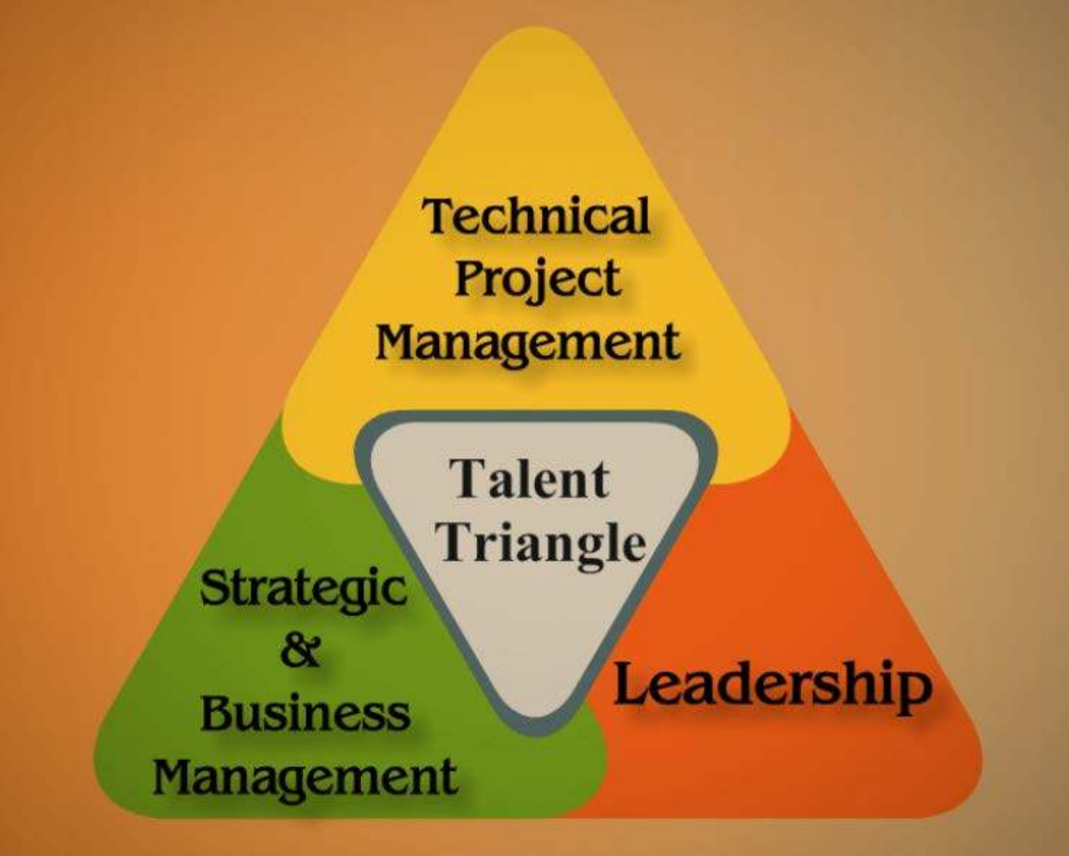
PMI Talent Triangle® and Importance of
Leadership Skills
n PMI developed a talent triangle to emphasize the types of skills project managers need to develop continuously, including
1. Technical PM skills: understanding the knowledge areas, process groups, PM tools and techniques, etc.
2. Strategic and business management skills: strategic planning and financial management, accounting, marketing, and other management topics
3. Leadership skills: focusing on long-term goals and big-picture objectives,
while inspiring people to reach these goals. Leadership is a soft skill, and no single best way to be a good leader.
20

Slide 25
Careers for IT Project Managers
n In a 2017 survey, IT executives listed the “ten hot tech skills” they
planned to hire for in 2017. Project management ranked 2nd, after full- stack software development.
n Even if you stay in a technical role, you still need PM knowledge and skills to help your team and organization
1. Full-stack software development
2. Project management
3. Cyber-security
4. Networking
5. User experience/user interface (UX/UI) design
6. Quality assurance (QA)/testing
7. Cloud engineering
8. Big data
9. Machine learning/artificial intelligence
10. DevOps
Table 1-4 Ten hot tech skills for 2017
[Source: Sharon Florentine, “10 IT skills that employers need in
2017,” CIO from IDG (February 1, 2017).]
21

Slide 26
History of Project Management (1 of 2)
n Some people argue that building the Egyptian pyramids was a project, as was building the Great Wall of China
n Most people consider the Manhattan Project to be the first project to use “modern” project management
This three-year, $2 billion (in 1946 dollars) project had a separate project manager and a technical manager
n In the 1990s, many companies began creating PMOs to help them handle the increasing number and complexity of projects
A Project Management Office (PMO) is an organizational unit responsible for coordinating the PM function throughout an organization
22

Slide 27
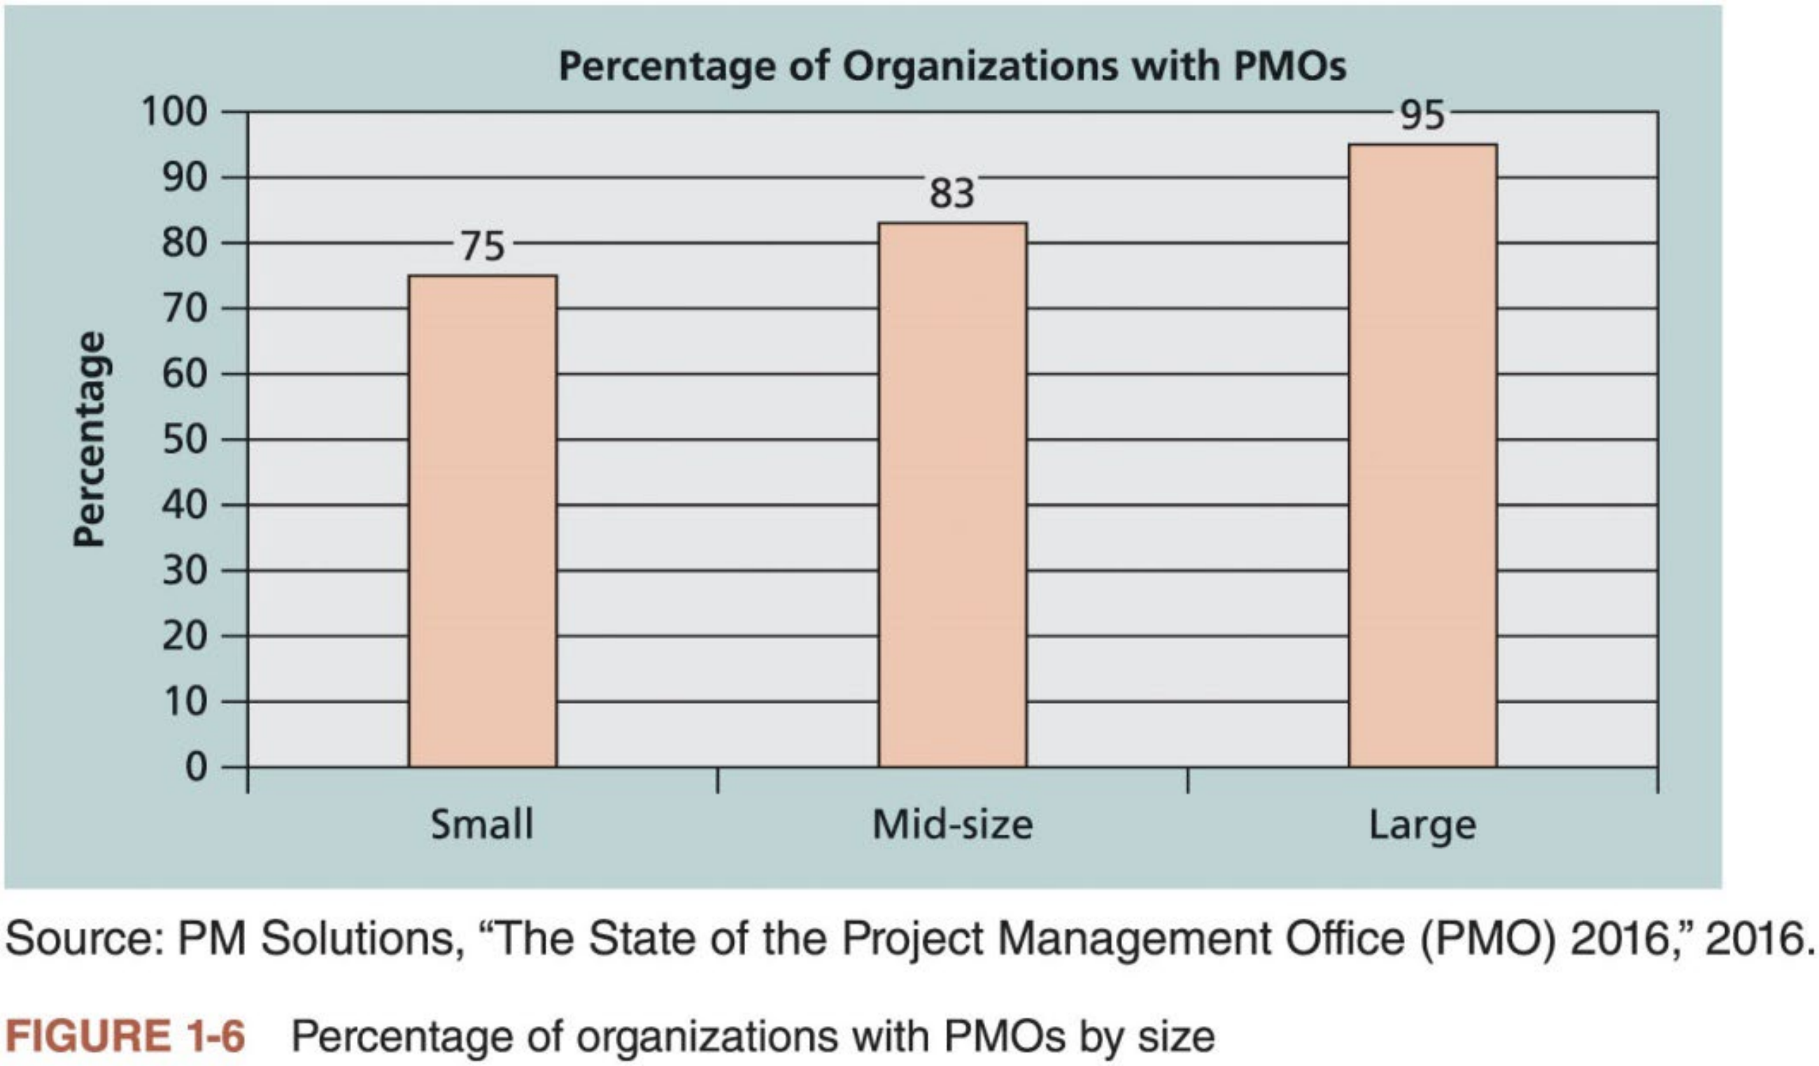
History of Project Management (2 of 2)
23

Slide 28

Project Management Institute
n The Project Management Institute (PMI) is an international professional society for project managers founded in 1969
n PMI has continued to attract and retain members, reporting more than
500,000 members worldwide by late 2017 (and the figure has increased to almost 700,000 by now)
n There are communities of practices in many areas, like information systems, financial services, and health care
n Students can join PMI at a reduced fee and earn the Certified Associate in Project Management (CAPM) certification
n PMI Hong Kong Chapter
Established in 1997 as a local chapter of PMI
24

Slide 29
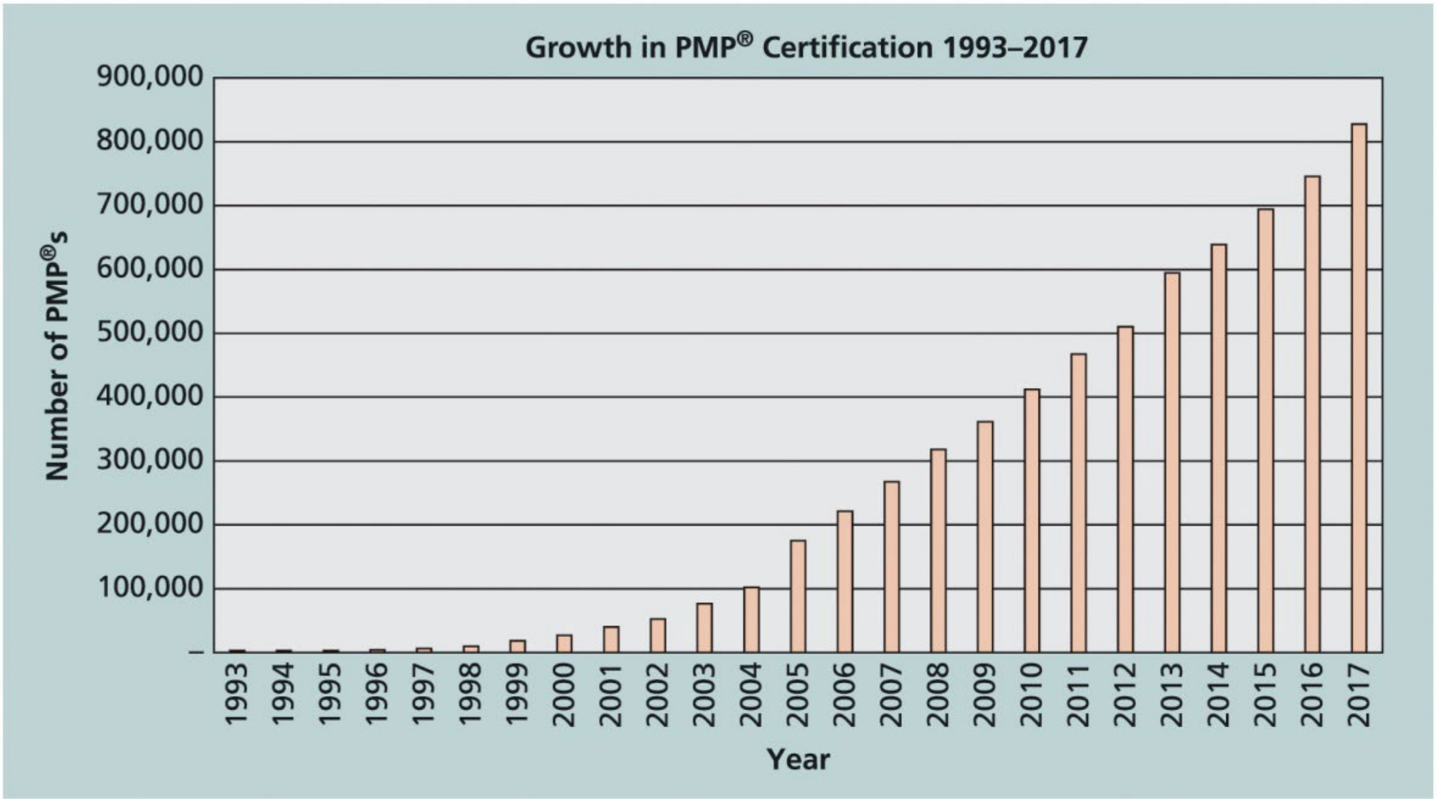
Project Management Certification
n PMI provides certification as a Project Management Professional
(PMP®). A PMP® has documented sufficient project experience, agreed to follow a code of ethics, and passed the PMP® exam.
n The number of people earning PMP® certification is increasing quickly.
25

Slide 30


Ethics in Project Management
n Ethics is a set of principles that guide our decision making based on personal values of what is “right” and “wrong”
n Making ethical decisions is an important part of project managers’ personal and professional lives because it generates trust and respect with other people
Project managers often face ethical dilemmas, such as whether to take
bribes, or to accept subpar work to meet deadline. Ethics guide us in making these types of decisions.
n PMI approved a Code of Ethics and Professional Conduct, which applies to PMP® and all PMI members
Including short chapters addressing vision and applicability, responsibility, respect, fairness, and honesty
It is vital for project managers to conduct their work in an
ethical manner!
26

Slide 31

Project Management Software
n There are hundreds of tools available products to assist in performing project management
Deciding which PM software to use has become a project itself.
n Three main categories of tools:
Low-end tools: Handle single or smaller projects well
Midrange tools: Handle multiple projects and users, Microsoft Projectis still the most popular
High-end tools: Also called enterprise project management software, often licensed on a per-user basis
n Several free or open-source tools are also available
Refer to Kathy Schwalbe’s website: https://pmtexts.com/free- resources/brief-guide-to-project-2010/
27

Slide 32
Project Management and IT Context
28

Slide 33

Systems View of Project Management
n Projects must operate in a broad organizational environment, and project
managers need to consider projects within the greater organizational context rather than in isolation
n Systems thinking takes a holistic view of carrying out projects within the context of the organization
n A systems approach emerged in the 1950s describes a holistic and analytical approach to solving complex problems that includes three parts:
Systems philosophy: an overall model for thinking about things as systems
Systems analysis: a problem-solving approach that requires defining the scope of the system, dividing it into components, and identifying and evaluating its problems, opportunities, constraints, and needs
Systems management: address the business, technological, and organizational issues associated with creating, maintaining and modifying a system
n Shortest path algorithm——>Navigation system
29

Slide 34
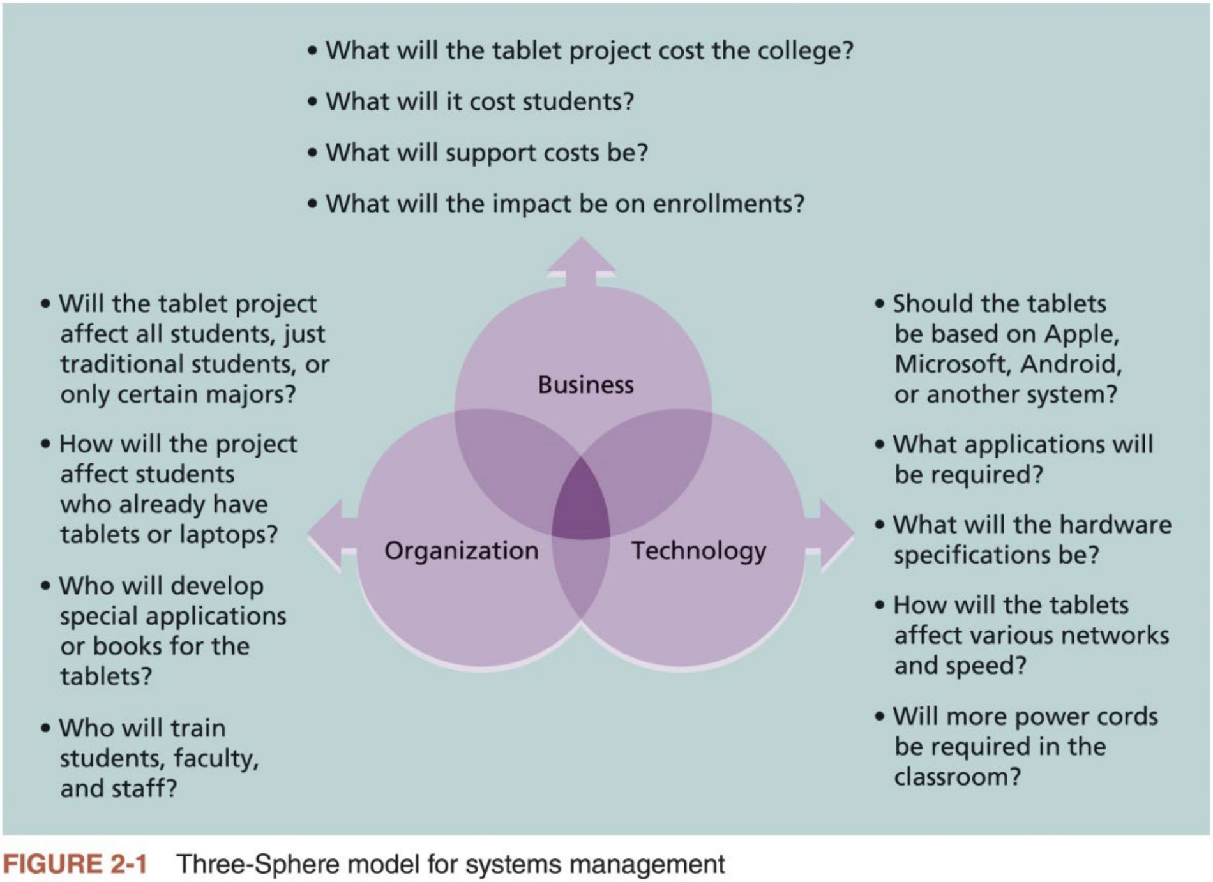
Three-Sphere Model for Systems Management
n Addressing the three spheres of systems management – business, organization, and technology – can have a huge impact on selecting and managing projects successfully
n Figure 2-1 provides a sample of these issues for a tablet project at a private college in the Opening Case of Chapter 2 of the textbook
30

Slide 35



Advice for Young Professionals
n Question: How can you begin to understand an organization’s business and organizational aspects?
Make it a priority. Don’t just focus on the technology, no matter how
exciting it seems to you. Even if you take just a few minutes each day learning about other aspects of the organization, that’s a start.
Tell your boss or other colleagues that you want to understand how the
entire organization works. Ask important questions like how the company makes money, who key customers are, what the priorities are for the year, what meetings you can attend or documents you can read to gain more
knowledge, etc.
Network, network, network! Find out which people inside or outside of your organization can help you in developing a systems approach. You might be surprised how quickly you can move up in your career once you understand the big picture.
31

Slide 36


Understanding Organizations
n Systems approach requires project managers always view their projects in the context of the larger organization
Organizational issues are often the most difficult part of working on and managing projects. Many people believe that most projects fail because of organizational issues like company politics.
Project managers often do not spend enough time identifying all the
stakeholders involved in projects, especially the people opposed to the projects
Also, they often do not spend enough time considering the political context of a project or the culture of the organization
n To improve the success rate of IT projects, it is important for project managers to develop a better understanding of people as well as
organizations
32

Slide 37
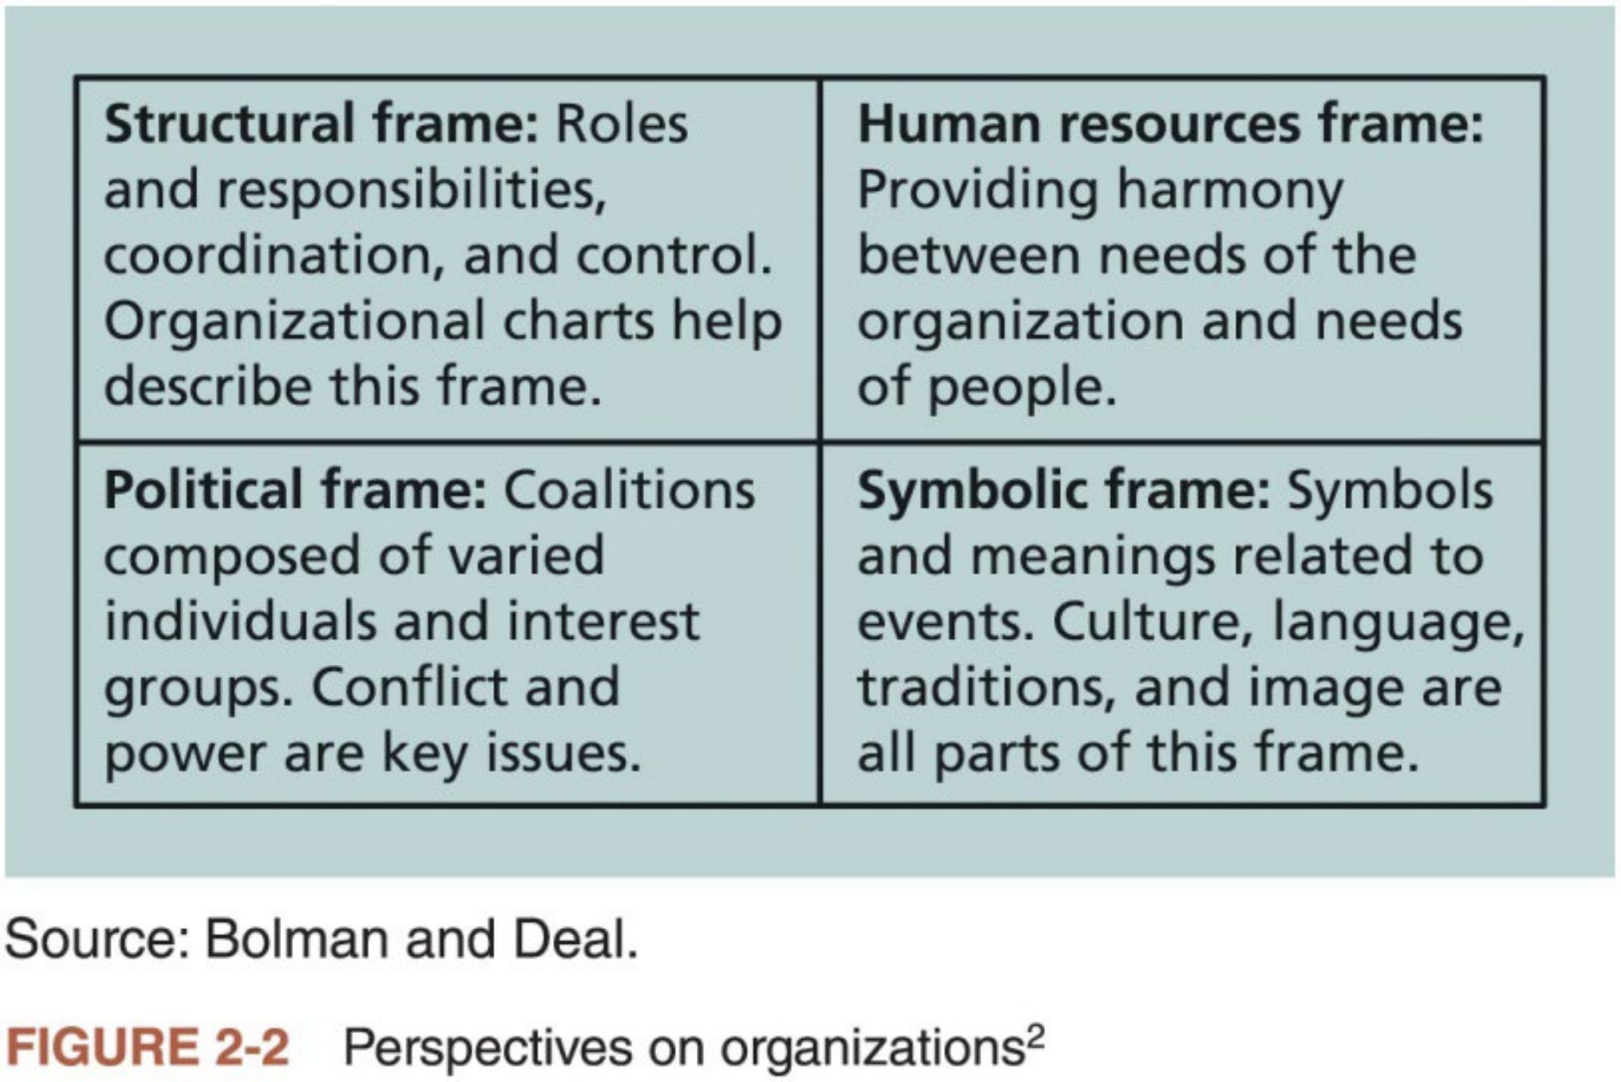
Four Frames of Organizations
n We can understand organizations better by focusing on different perspectives. They can be viewed as having four different frames:
structural, human resources (HR), political, and symbolic.
n Project managers must learn to work within all four frames to function well in organizations.
33

Slide 38
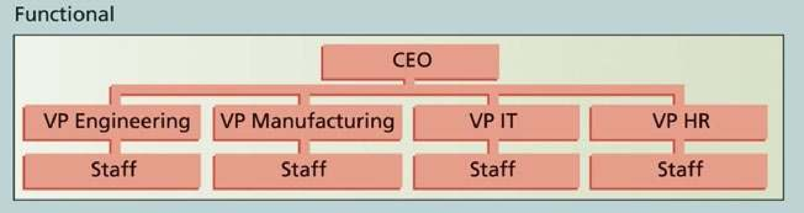
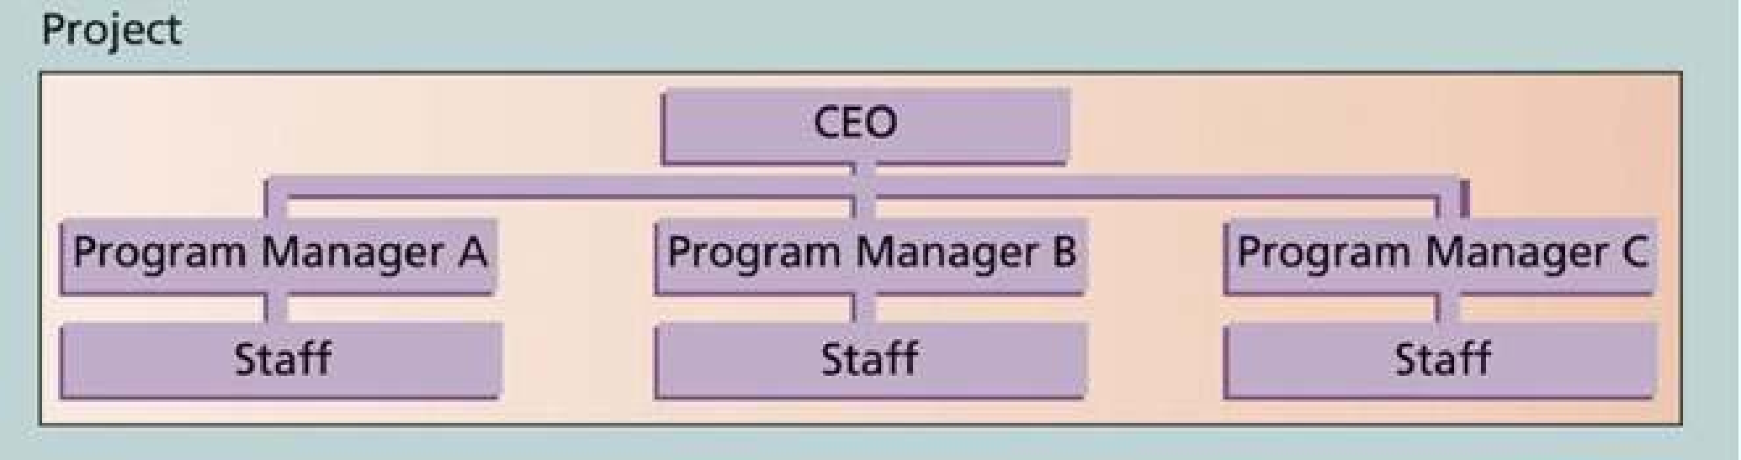
Organizational Structures (1 of 2)
n The structures of organizations can be generally classified into three forms: functional, project or project-oriented, and matrix
n Functional structure: functional managers or VPs in their specialties report to CEO. Their staffs have specialized skills in their respective disciplines.
n Project or project-oriented structure: program managers report to CEO. Their
staffs have a variety of skills needed to complete the projects within their
programs.
34

Slide 39
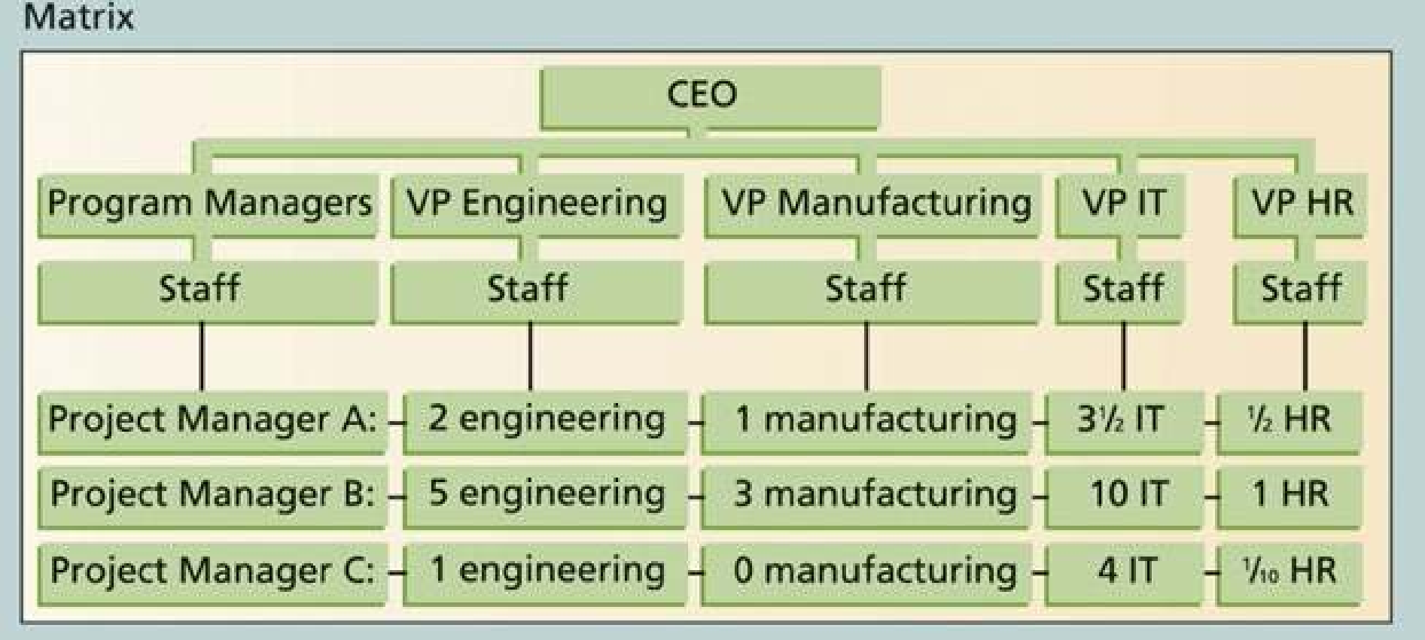
Organizational Structures (2 of 2)
n Matrix structure: middle ground between functional and project structures.
Personnel often report to a functional manager and to one or more project mangers. Project managers in matrix organizations have staff from various functional areas working on their projects.
n Important for project managers to understand their organizational structures
Project mangers have the most authority in a pure project-oriented
organizational structure, while the least authority in a pure functional organizational structure.
35

Slide 40
Organizational Culture
n Organizational culture is a set of shared assumptions, values, and behaviors that characterize the functioning of an organization
n Many experts believe the underlying causes of many companies’ problems are not the structure or staff, but their cultures
n Ten characteristics of organizational culture, identified by Robins and Judge, authors of a popular OB textbook:
1) Member identity* | 6) Risk tolerance *
2) Group emphasis * | 7) Reward criteria *
3) People focus | 8) Conflict tolerance *
4) Unit integration * | 9) Means-ends orientation
5) Control | 10) Open-systems focus *
Project work is most successful in an organizational culture where the * items are strong or high and the other items have a balanced focus
36

Slide 41
Focusing on Stakeholder Needs
n Project stakeholders are the people involved in or affected by project activities. They can be internal or external to the organization.
n Project managers must take time to identify, understand, and manage relationships with all project stakeholders
The purpose of project management is meet project requirements and satisfy stakeholders
Senior executives or top management are very important stakeholders
n Using four frames of organizations to think about project stakeholders helps project mangers to meet their expectations
Structural, human resources, political, and symbolic frames
n We will study in more details Project Stakeholder Management in Lecture 11
37

Slide 42

Top Management Commitment
n A crucial factor in helping project managers successfully lead projects is
the level of commitment & support from top management
Without top management’s commitment & support, many projects will fail.
n Some projects have a senior manager called a champion who acts as a key advocate for a project
n How can top management help project managers?
1. Providing adequate resources (e.g., money, human resources, visibility)
2. Approving unique project needs in a timely manner
3. Coordinating people from other parts of the organization and dealing with political issues
4. Mentoring and coaching on leadership issues
n IT project managers work best in a company environment in which top management values IT
38

Slide 43


Need for Organizational Commitment to Information Technology
n The organization’s commitment to IT is another important factor that affects the success of IT projects
Very difficult for an IT project to be successful if the organization itself does not value IT（互联网公司除外）
n Many companies have created a VP or equivalent position, called Chief Information Officer (CIO), for the head of IT
Some CEOs take a strong leadership role in promoting the use ofIT in their organizations
The leadership style of the CIO plays a crucial role in gaining
organizational commitment to IT as well as motivation and support for IT workers
n Empowering employees at all levels to effectively use IT is also crucial
39

Slide 44
Need for Organizational Standards
n Top management must support the development of standards or guidelines to follow when performing project management and encourage or even enforce their use
Examples: standard forms or templates for common project documents,
examples of good PM plans, or guidelines for project managers to provide status information to top management
n Some organizations create a PMO or center of excellence to assist project managers in achieving project goals and maintaining project governance
n Some organizations develop career paths for project managers, and some require that all project managers have PMP® certification and that all
employees have some type of PM training.
40

Slide 45
Project Life Cycle (1 of 2)
n A project life cycle is a collection of project phases. Projects pass through these phases from their start to completion.
n PMBOK® Guide (2017) describes the generic life cycle to include the
following phases: 1) starting the project; 2) organizing and preparing;
3) carrying out the work; and 4) finishing the work.
n Project life cycles define the followings in each phase
what work will be performed in each phase
what deliverables will be produced and when
who is involved in each phase
how management will control and approve work produced in each phase
n A deliverable is a product or service produced or provided as part of a project
41

Slide 46


Project Life Cycle (2 of 2)
n In early phases of a project life cycle, resource needs are usually the lowest and the level of uncertainty & risk is the highest.
Project stakeholders have the greatest opportunity to influence the final characteristic of the project’s products, services, or results.
Much more expensive to make major changes in the latter phases
n During the middle phases, the certainty of completing the project
improves as it continues, and as more information is known about the project requirements and objectives.
The resources are usually needed the most during the middle phases
n The final phase focuses on ensuring that project requirements were met, and the sponsor approves completion of the project.
42

Slide 47
Product Life Cycles (1 of 3)
n A product life cycle is a process used to define, create, and deliver products. All products follow some type of life cycle.
n Five product or development life cycles from PMBOK® Guide (2017)
1. Predictive life cycle: scope, schedule, and cost are determined early, and changes to scope are carefully managed.
2. Iterative life cycle: scope is determined early, but time and cost estimates are modified as the understanding of the product increases.
3. Incremental life cycle: deliverables are produced through a series of iterations that add functionality within a set time frame.
4. Adaptive life cycle: stakeholders define and approve the detailed scope before the start of an iteration, producing a usable product at the end of each iteration. Also referred to as agile or change-driven.
5. Hybrid life cycle: combination of the above four life cycles.
43

Slide 48

Product Life Cycles (2 of 3)
n Two factors in deciding which life cycle to use: 1) the degree of change in requirements; and 2) the frequency of delivery of useful results
Low change & Low frequency => Predictive life cycle; High change & High frequency => Adaptive life cycle
n Systems development life cycle (SDLC)¹ is a framework for describing the phases of developing information systems
n Several SDLC models
Waterfall model has well-defined, linear stages of systems analysis, design, construction, testing, and support.
Spiral model uses an iterative or spiral approach. Figure 2-4 illustrates the differences between the waterfall and spiral life cycle models.
Prototyping model is used for developing software prototypes to clarify user requirements for operational software.
Rapid Application Development (RAD) model is used to produce systems quickly without sacrificing quality.
¹SDLC: https://www.techtarget.com/searchsoftwarequality/definition/systems-development-life-cycle
44

Slide 49
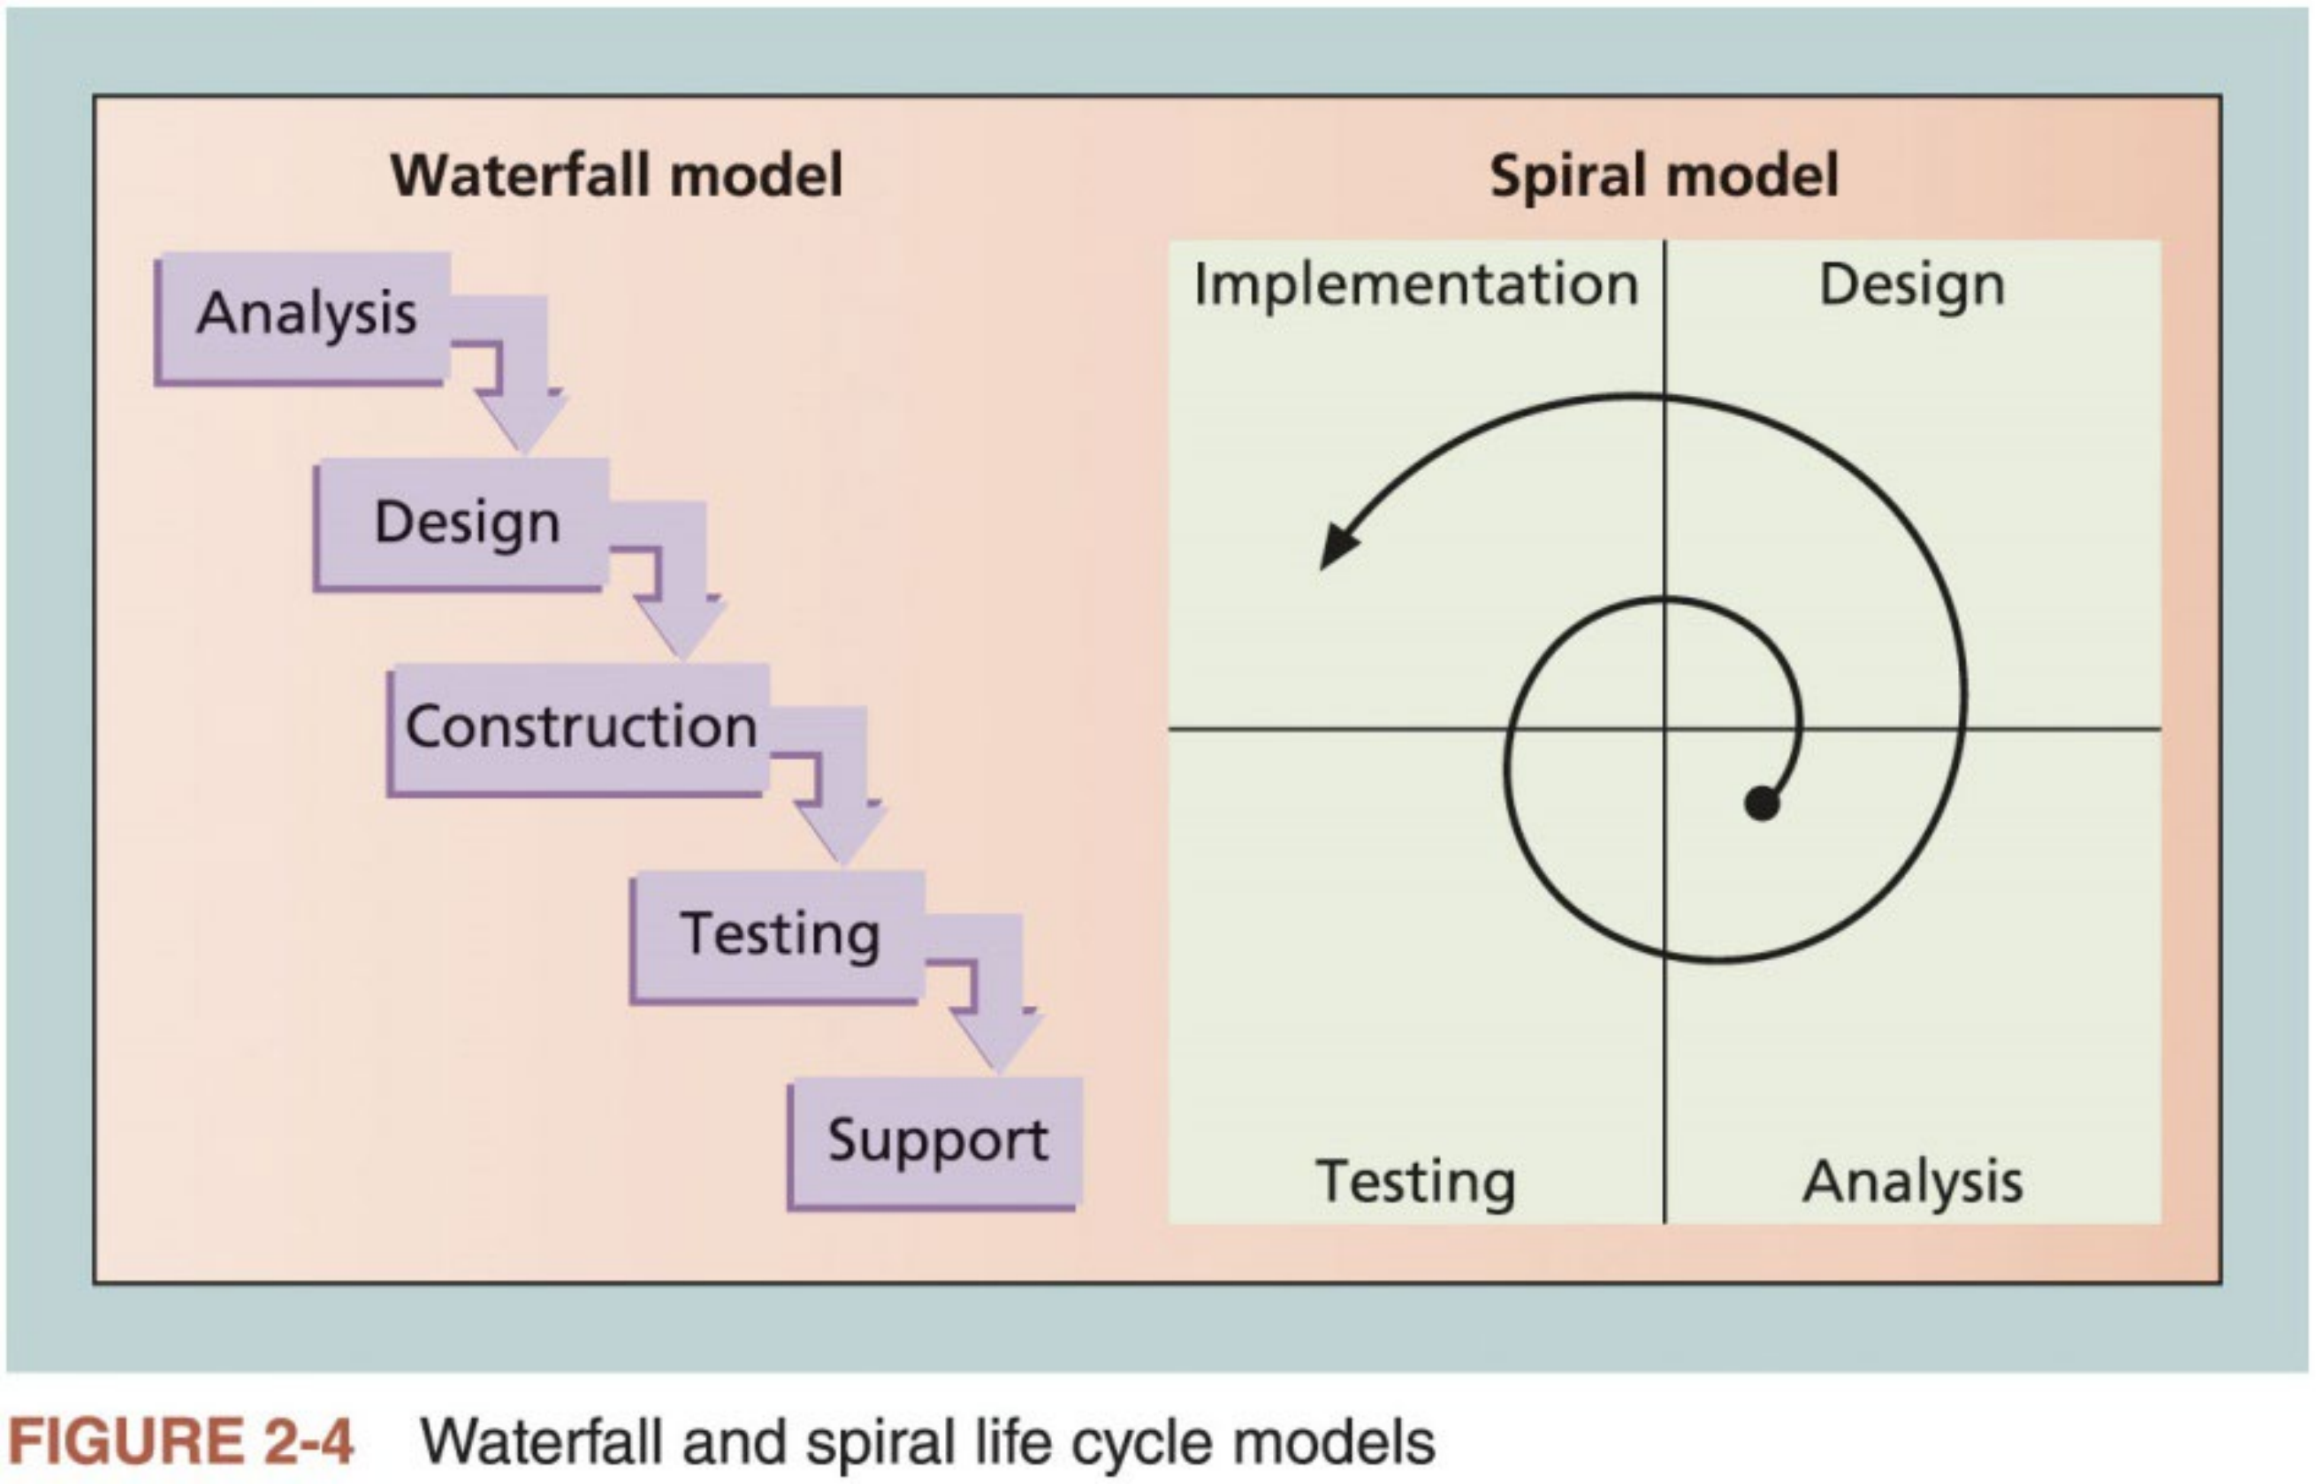
Product Life Cycles (3 of 3)
45

Slide 50

Importance of Project Phases and Management Reviews
n A project should successfully pass through each of the main project phases before continuing to the next
n Management reviews, also called phase exits, phase gate reviews, or kill points, are very important for keeping projects on track and determining if they should be continued, redirected, or terminated
Occur after each phase to evaluate the project’s progress, like success, and continued compatibility with organizational goals
n Also, important to have top management involvement throughout the life cycle of most projects
Many projects are reviewed by management on a regular basis to make sure they are progressing well.
Do not wait until the end of project or product phases to seek inputs from upper management.
46

Slide 51
The Context of IT Projects
n The project context has a critical impact on which product development life cycle will be most effective for a particular software development project
n Likewise, several issues unique to the IT industry have a critical impact on managing IT projects
1. The nature of IT Projects
2. The characteristics of IT project team members
3. The diverse nature of technologies involved
47

Slide 52



Nature of IT Projects
n Unlike projects in many other industries, IT projects are very diverse
IT projects can be very diverse in terms of size, complexity, products produced, application area, and resource requirements
The nature of software development projects is even more diverse than
hardware-oriented projects
n Important to develop and follow best practices in managing the diversified IT projects
Developing best practices gives IT project managers a common starting point and method to follow with every project
48

Slide 53



Characteristics of IT Project Team Members
n People involved in IT projects come from diverse background & possess different skills
n Diverse project teams provide a significant advantage
They analyze project requirements from a robust systems view
Many companies purposely hire graduates in other fields such as business and mathematics to provide different perspectives on IT projects
n Some IT projects require the skills of people in just a few job functions, but some projects require inputs from many or all of them
IT professionals often become technical experts in one area, or they decide to move into a management position.
Technical specialists or project managers rarely remain with the same company for a long time
Many IT projects include many contract workers, working with whom creates special challenges
49

Slide 54




Diverse Technologies
n Different IT professionals require different technologies, which can make communication between professionals challenging
Hardware specialist may not understand the language of database analysts. Security specialists may find it hard to communicate with business analyst.
Project managers may find it more difficult to form and lead versatile IT project teams
n IT technologies change rapidly
A project team might be close to finishing a project when it discovers a new technology that can greatly enhance the project and better meet long-term
business needs.
New technologies have also shortened the time frame many businesses have to develop, produce, and distribute new products and services.
This fast-paced environment requires equally fast-paced processes to manage and produce IT projects and products.
50

Slide 55

Agile Project Management
n Agile means being able to move quickly and easily, but some people feel that project management, as they have seen it used, does not allow
people to work quickly or easily
n Early software development projects often used a waterfall approach
This approach is often difficult to use as technology and businesses become
more complex, because requirements were unknown or continuously changing
n Agile today means using an approach where requirements and solutions evolve through collaboration
51

Slide 56
Agile Project Management
nn Manifesto for Agile Software Development
In February 2001, a group of 17 people called “the Agile Alliance” developed and agreed on the Manifesto for Agile Software Development, as follows:
“We are uncovering better ways of developing software by doing it and helping others do it. Through this work we have come to value:
1) Individuals and interactions over processes and tools;
2) Working software over comprehensive documentation;
3) Customer collaboration over contract negotiation;
4) Responding to change over following a plan.
51

Slide 57
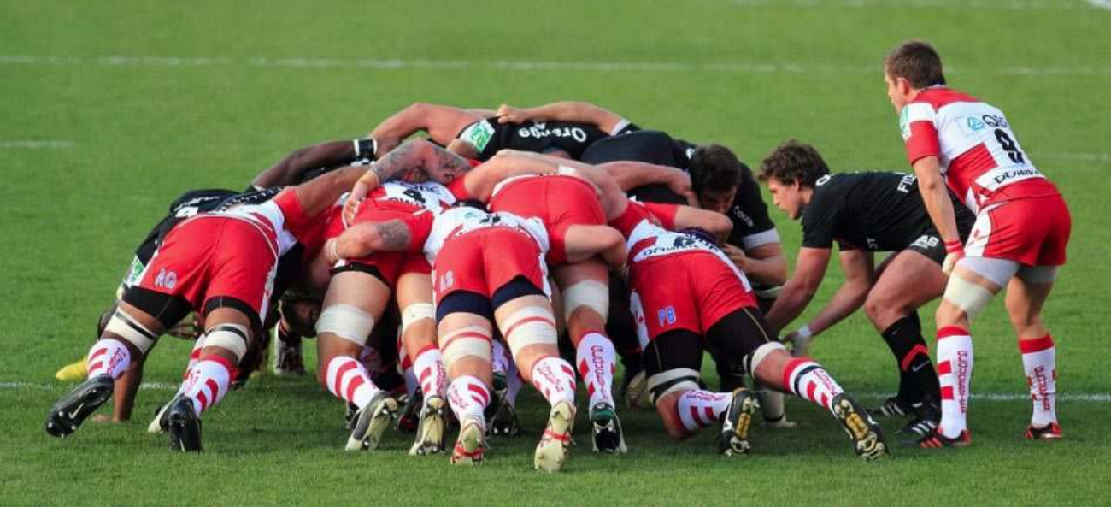
Scrum²
n Scrum is the leading agile development method for completing projects with a complex, innovative scope of work
n The term was coined in 1986 in a Harvard Business Review study that compared high-performing, cross-functional teams to the scrum
formation used by rugby（英式橄榄球） teams.
n In the Axosoft video “Scrum in 10 Minutes”, Hamid Shojaee, an
experienced software developer, briefly explains all the core Scrum concepts like product backlogs, team roles, sprints, and burndown charts, and more.
https://v.youku.com/v_show/id_XODAyMTU1NTg0.html?
²Wikipedia: https://en.wikipedia.org/wiki/Scrum_(software_development)
52

Slide 58
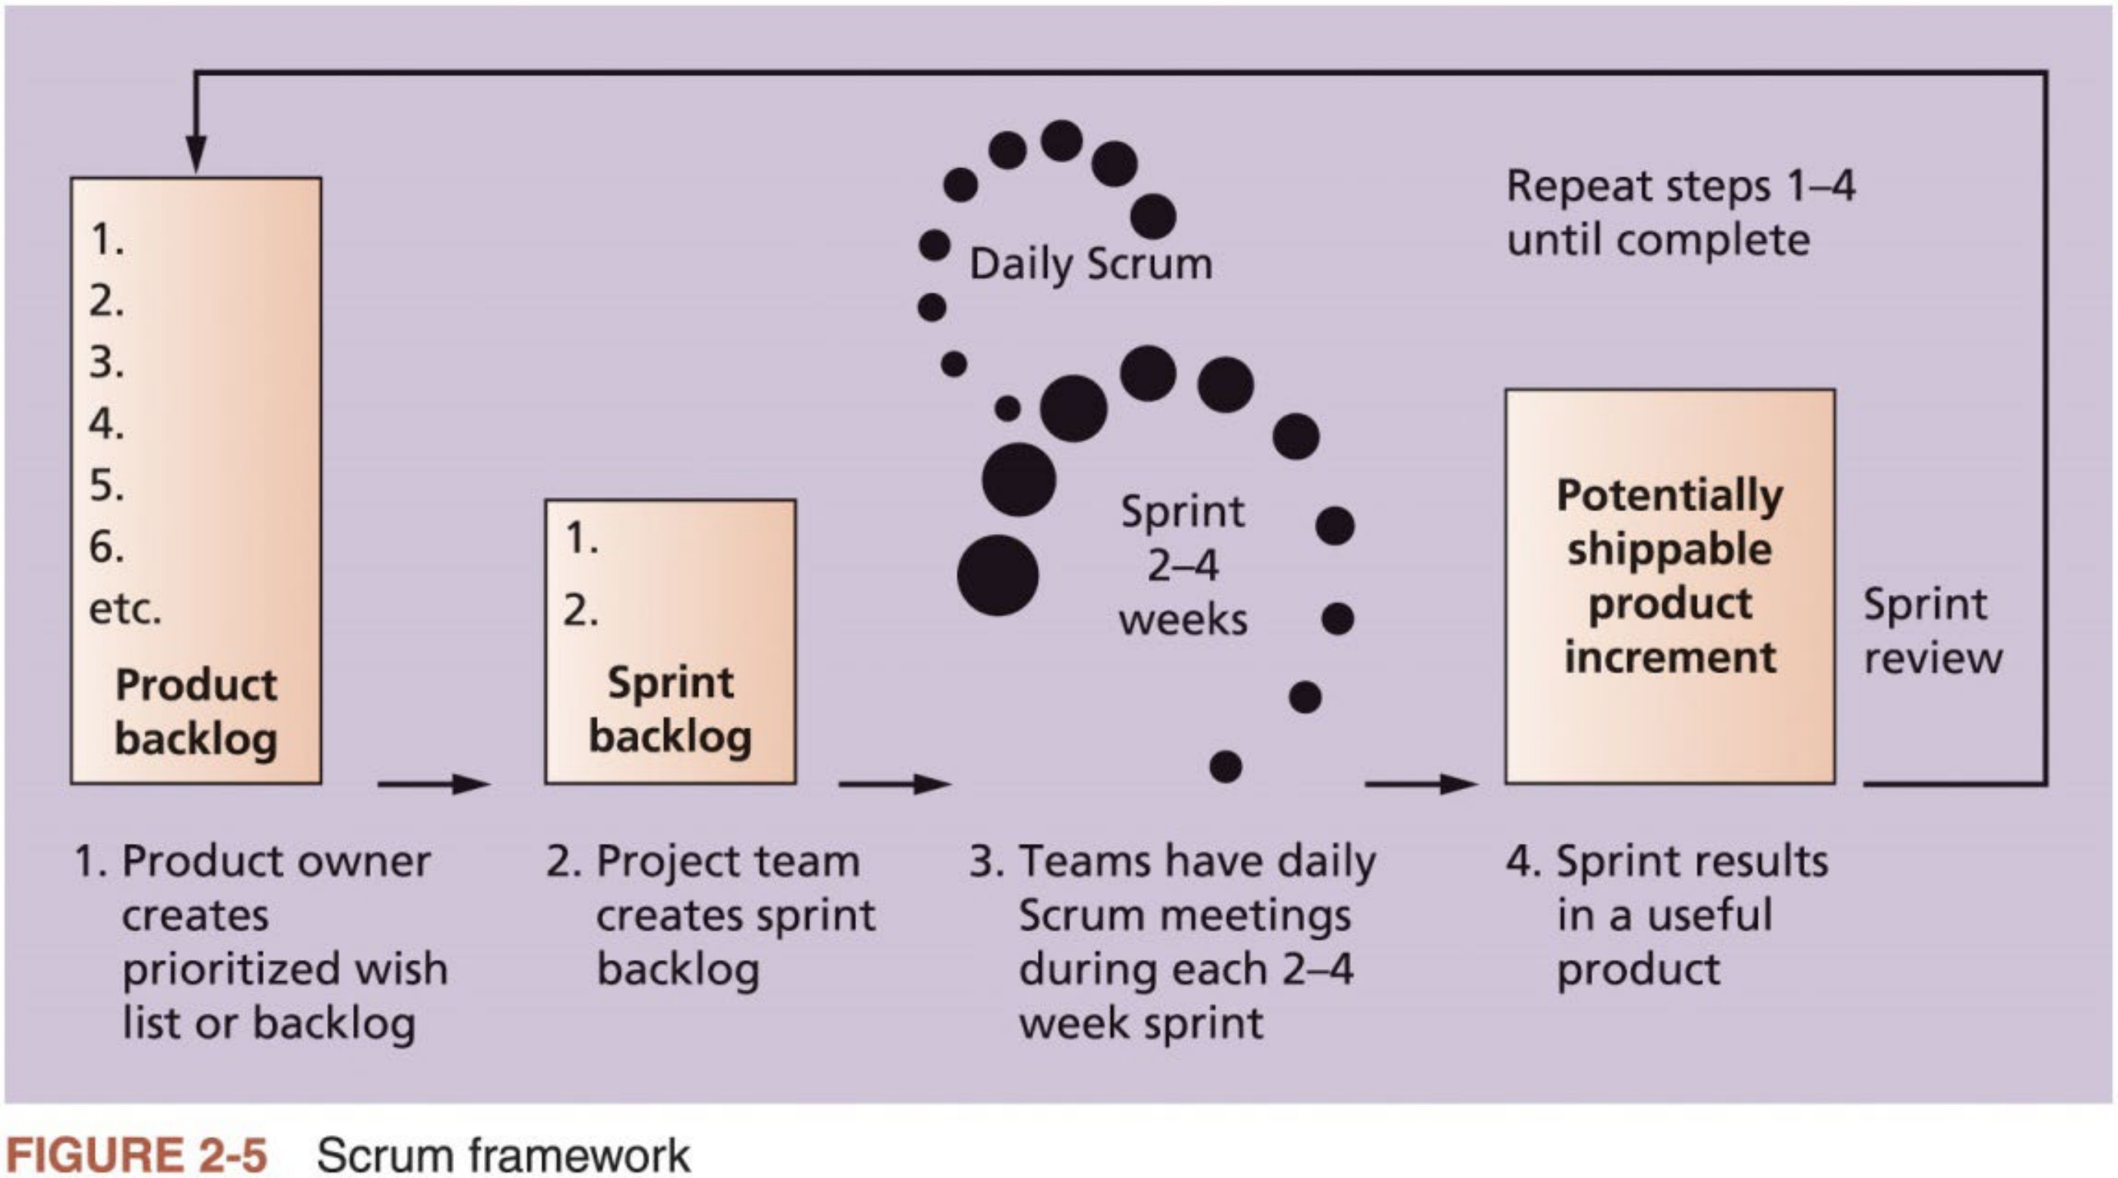
Scrum Framework
53

Slide 59
Agile, the PMBOK® Guide, and A New Certification
n The PMBOK® Guide (2017) describes best practices for what should be done to manage projects
n Agile is a methodology that describes how to manage projects
n PMI recognized the increased interest in Agile and introduced a new certification in 2011 called Agile Certified Practitioner (ACP)
18,239 people earned the ACP certification by the end of Nov 2017
n Seasoned project managers understand that they have always had the option of customizing how they run projects
Project management is not easy, even using Agile
54

Slide 60

Complementary Reading
n Chapter 1 “Introduction to Project Management” of Schwalbe (2018)
A free PDF version is available at
https://kathyschwalbe.files.wordpress.com/2018/06/schwalbe-itpm-9e-chapter-1.pdf
n Chapter 2 “The Project Management and Information Technology Context” of Schwalbe (2018)
n Chapters 1 to 3 in Part 1 of PMBOK® Guide (2017)
55

